Slide 1

ITS30705 CHAPTER 4: CONDITIONAL EXECUTION

Slide 2
CONTENT
The if/else statement
Accessing Strings using Indexes

Slide 3
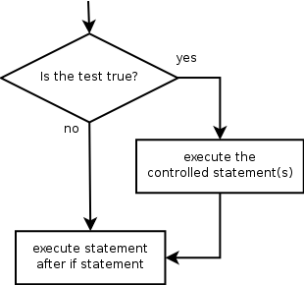
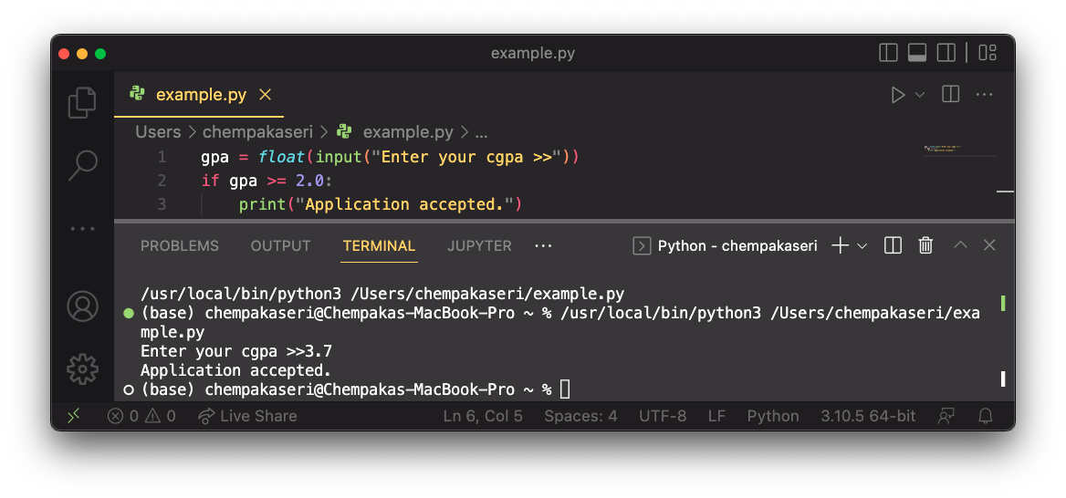
THE “if” statement
Executes a block of statements only if a test is true
Syntax:
Example:
if test:
statement
...
statement

Slide 4
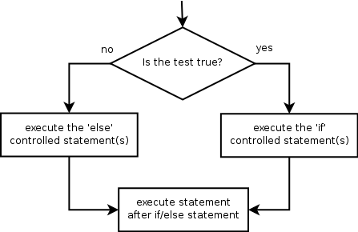
THE “if” statement
Executes a block if a test is true, another if false
Syntax:
if test:
statement(s)
else:
statement(s)

Slide 5
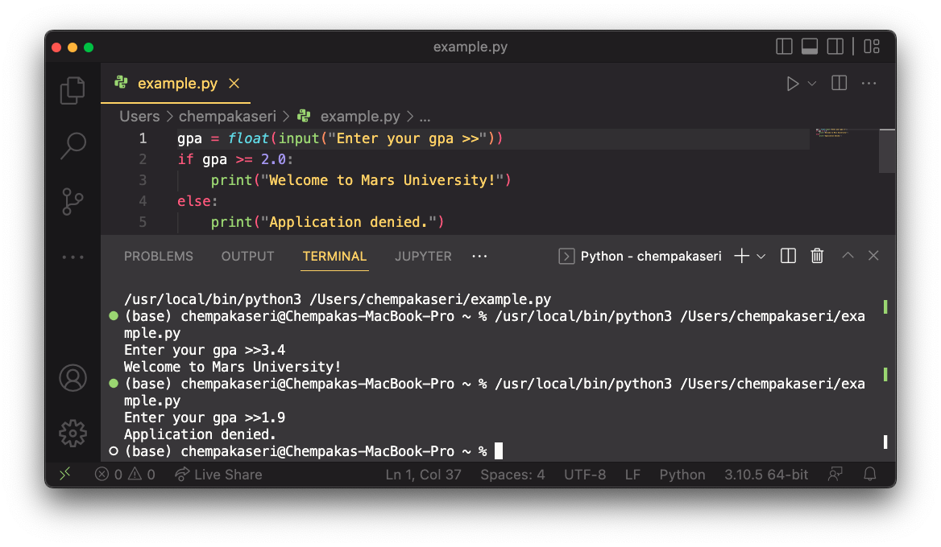
THE “if” statement
Example:

Slide 6
Operator – relational operator
if statements use logical test
Tests use relational operators
Operator | Name | Example
== | Equal | x == y
!= | Not equal | x != y
> | Greater than | x > y
< | Less than | x < y
>= | Greater than or equal to | x >= y
<= | Less than or equal to | x <= y

Slide 7
Operator – logical operator
Used to combine conditional statements
Operator | Description | Example
and | Returns True if both statements are true | x > 5 and x < 10
or | Returns True if one of the statements is true | x < 5 or x < 10
not | Reverse the results, returns False if the result is True | not (x > 5 and x < 10)

Slide 8
OPERATOR – IDENTITY OPERATOR
Used to compare the objects, not if they are equal, but if they are actually the same object, with the same memory location.
Operator | Description | Example
is | Returns True if both variables are the same object | x is y
is not | Returns True if both variables are not the same object | x is not y

Slide 9
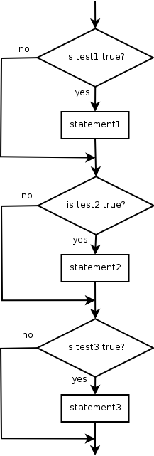
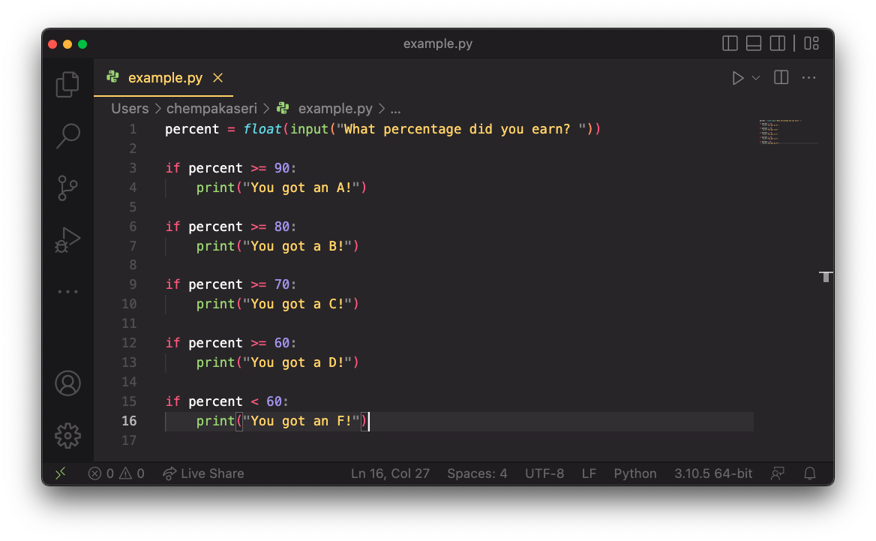
Misuse of if
What’s wrong with the following code?

Slide 10
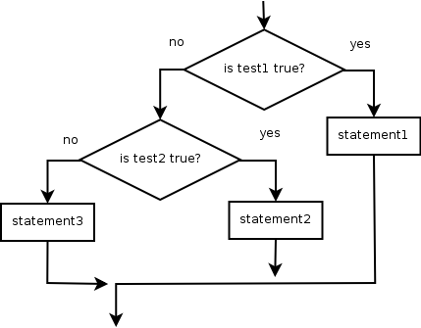
if/else AND if/elif/else
Chooses between outcomes using many tests
Syntax:
if test:
statement(s)
elif test:
statement(s)
else:
statement(s)

Slide 11
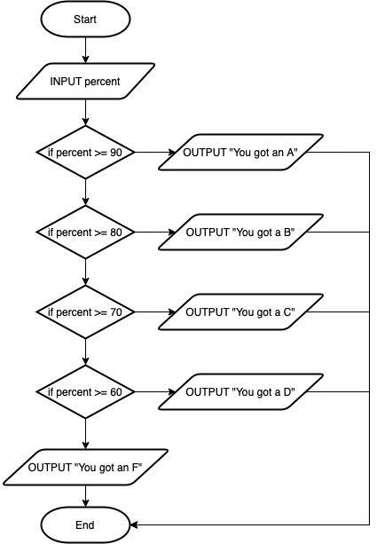
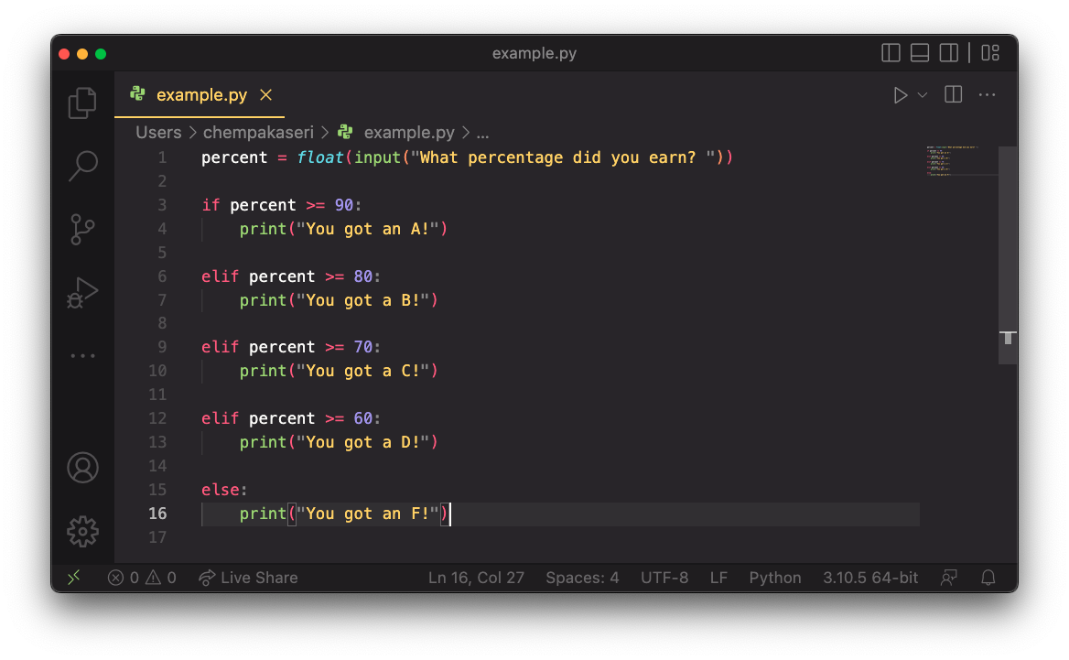
if/else
Example:

Slide 12
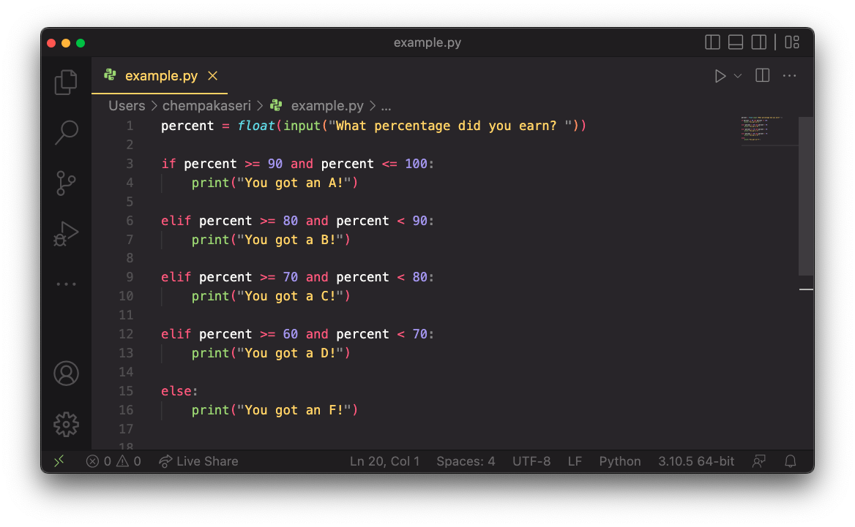
if/else
Example:

Slide 13
if structures
Exactly 1 path (mutually exclusive)
0 or 1 path (mutually exclusive)
if test:
statement(s)
elif test:
statement(s)
else:
statement(s)
if test:
statement(s)
elif test:
statement(s)
elif test:
statement(s)
0, 1, or many paths (independent tests; not exclusive)
if test:
statement(s)
if test:
statement(s)
if test:
statement(s)

Slide 14
NESTED if/else AND if/elif/else
We can have a if...elif...else statement inside another if...elif...else statement. This is called nesting in computer programming.
Any number of these statements can be nested inside one another. Indentation is the only way to figure out the level of nesting. They can get confusing, so they must be avoided unless necessary.

Slide 15
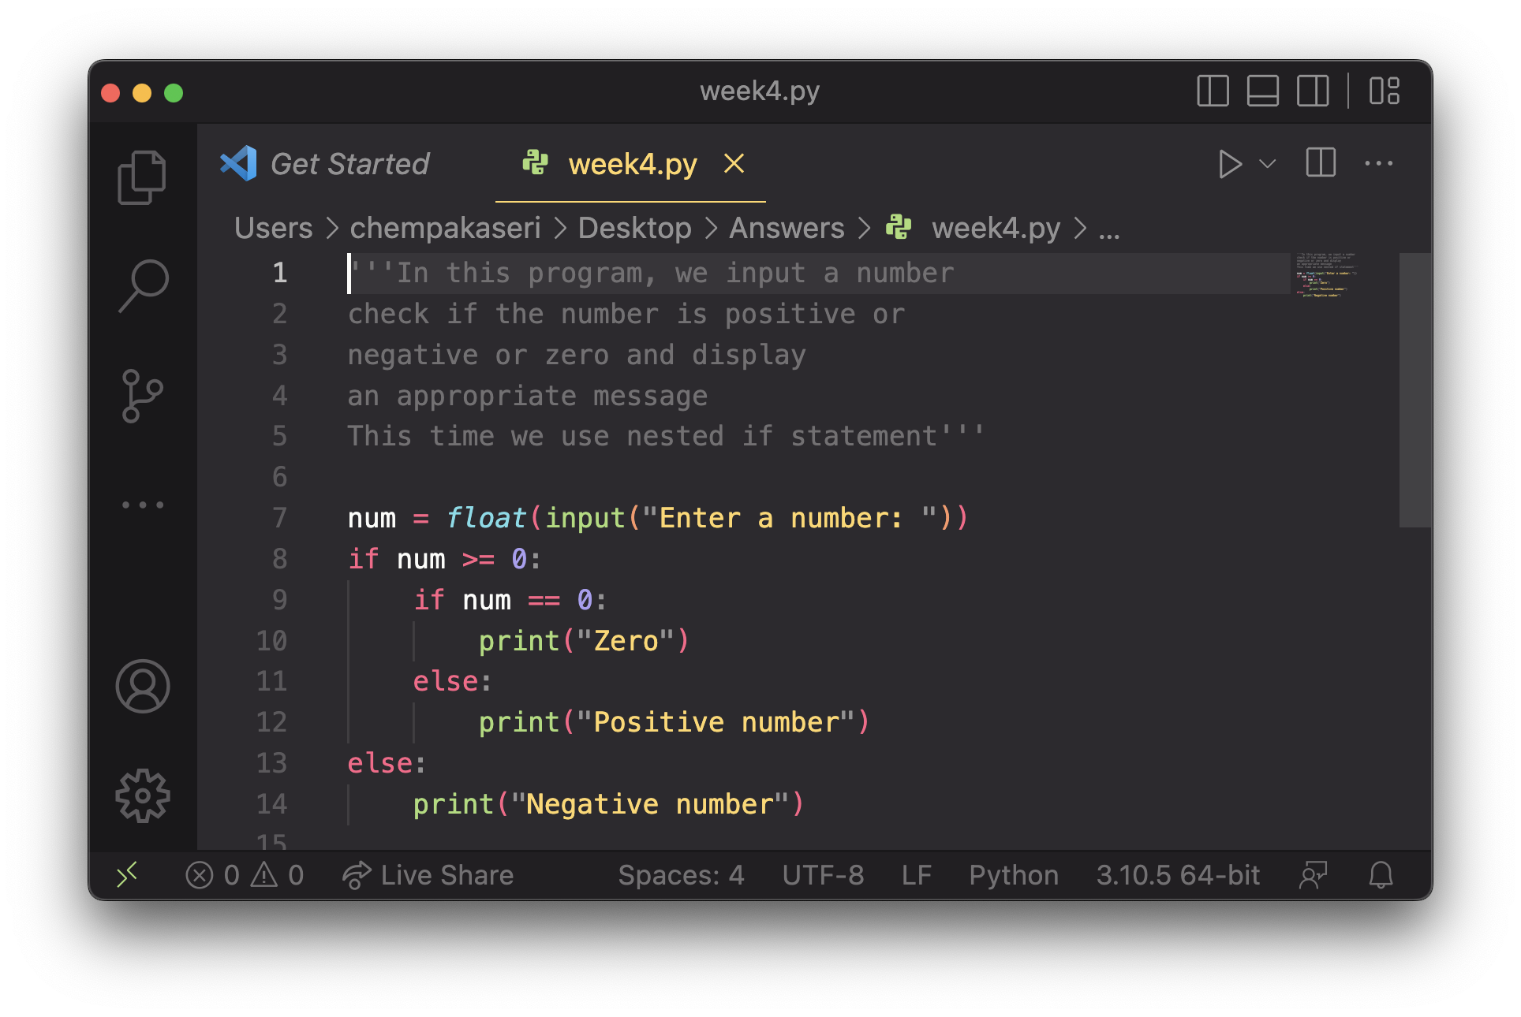
NESTED if/else AND if/elif/else

Slide 16
EXERCISE – if/else
if/if/if (2) if/else (3) if/elif/elif
Whether a user is lower, middle, or upper-class based on income
Whether you made the dean’s list (GPA >= 3.8) or honor roll (3.5-3.8)
Whether a number is divisible by 2,3 and/or 5
Computing a grade of A,B, C, D or F based on percentage
(2)
(3)
(1)
(2)

Slide 17
EXAMPLE - Question
This program reads data for people and computes their basal metabolic rate.
Formula for Basal Metabolic Rate Formula:
Output example
male BMR = 4.54545 x (weight in lb) + 15.875 x (height in inches) - 5 x (age in years) + 5
female BMR = 4.54545 x (weight in lb) + 15.875 x (height in inches) - 5 x (age in years) - 161
BMR | Burn Level
below 12000 | low
1200 to 2000 | moderate
above 2000 | high
Enter person's information:
height (in inches)? 71
weight (in lb)? 220.5
age (in years)? 20
gender (male or female)? female
The person basal metabolic rate = 1868.4
moderate resting burn rate

Slide 18
EXAMPLE – QUESTION
Start
INPUT height, weight, age, gender
gender == ”male”
True
bmr = 4.54545 * weight + 15.875 * height - 5 * age + 5
Identify the input, output and process of the problem.
Input:
Process:
Output:
Height, Weight, Age and Gender
False
bmr = 4.54545 * weight + 15.875 * height - 5 * age - 161
Calculate the BMR of the person
(male and female)
bmr >= 2000
True
OUTPUT high
Burn Level
False
bmr >= 1200 and bmr < 2000
True
OUTPUT moderate
False
OUTPUT low
End

Slide 19
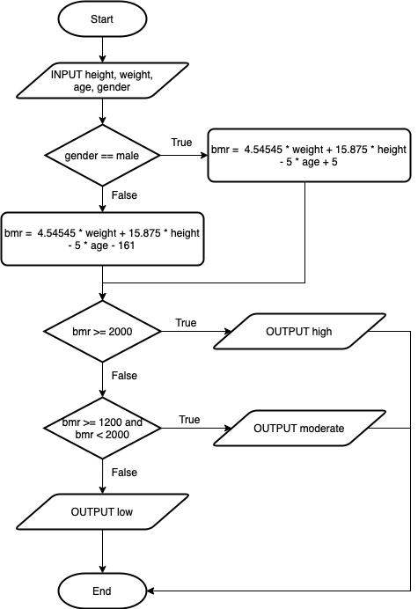
EXAMPLE - QUESTION
Input:
Check gender:
print("Enter person's information:")
height = float(input("height (in inches)? "))
weight = float(input("weight (in lb)? "))
age = int(input("age (in years)? "))
gender = input("gender (male or female)? ")
def bmr_calculator(gender):
bmr = 4.54545 * weight + 15.875 * height - 5 * age
if gender.lower() == "male":
bmr += 5
elif gender.lower() == "female":
bmr -= 161
else:
bmr = 0
return bmr

Slide 20
Example - question
Check bmr level:
Print output:
def bmr_level(bmr):
if bmr >= 2000:
return "High"
elif bmr >= 1200 and bmr < 2000:
return "Moderate"
else:
return "Low"
bmr = bmr_calculator(gender)
level = bmr_level(bmr)
print("The person basal metabolic rate =",round(bmr,1))
print(level, "resting burn rate")

Slide 21
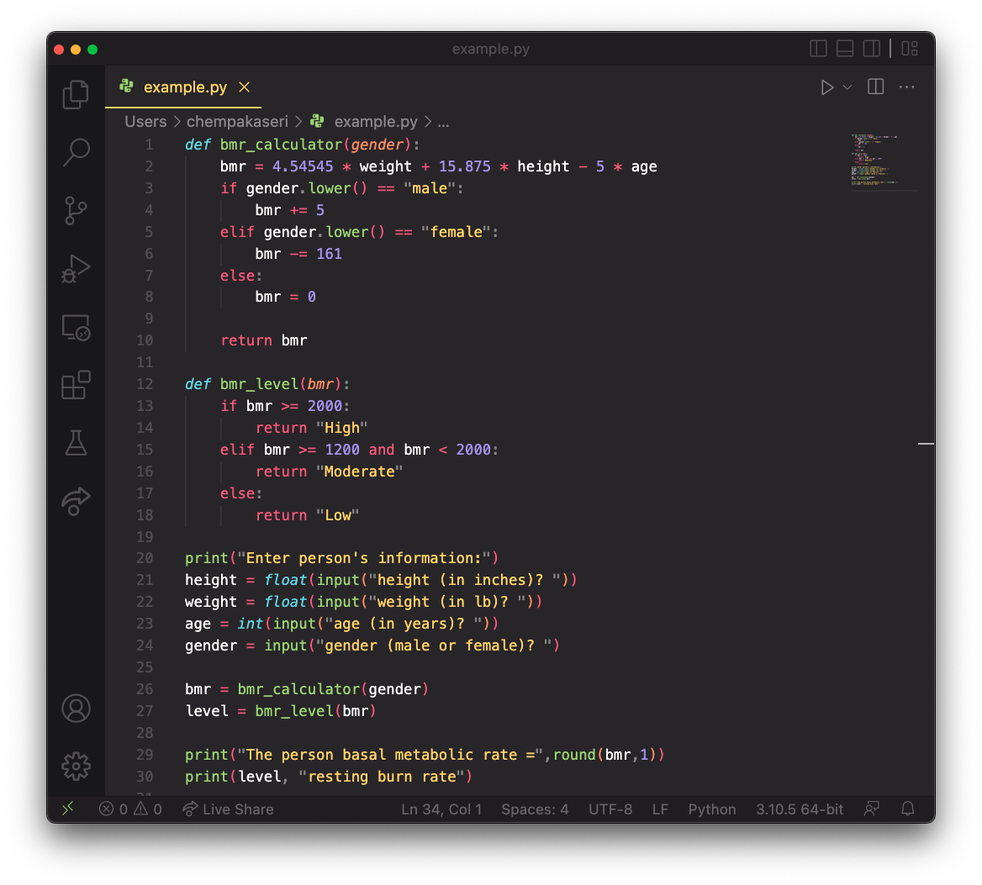

Slide 22
Factoring if/else code
Factoring: Extracting common or redundant code
Can reduce or eliminate redundancy from if/else code
Example:
if a == 1:
print(a)
x = 3
b = b + x
elif a == 2:
print(a)
x = 6
y = y + 10
b = b + x
else:# a == 3
print(a)
x = 9
b = b + x
print(a)
x = 3 * a
if a == 2:
y = y + 10
b = b + x

Slide 23
ACCESSING STRING USING INDEXES
String: A data type that stores a sequence of text characters
Example:
Characters of a string are numbered with 0-based indexes:
First character’s index: 0
Last character’s index: 1 less than the string’s length
name = "Ultimate"
index | 0 | 1 | 2 | 3 | 4 | 5 | 6 | 7
 | -8 | -7 | -6 | -5 | -4 | -3 | -2 | -1
character | U | l | t | i | m | a | t | e

Slide 24
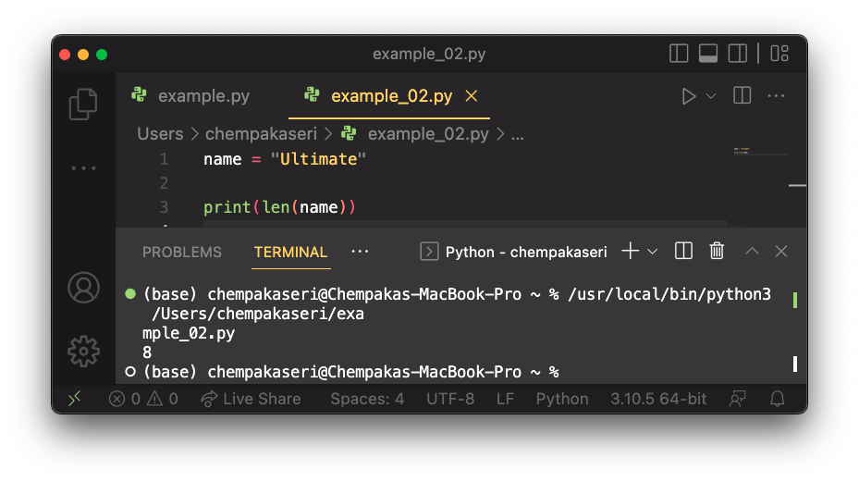
Accessing string using indexes
Access a character with string[index]:
Output: a
Access a substrings with string[start:stop]:
Output: tim
Start from beginning but ends in the middle:
Output: Ult
print(name[5])
print(name[2:5])
print(name[:3])
Start at the middle:
Output: mate
index | 0 | 1 | 2 | 3 | 4 | 5 | 6 | 7
 | -8 | -7 | -6 | -5 | -4 | -3 | -2 | -1
character | U | l | t | i | m | a | t | e
print(name[4:])

Slide 25
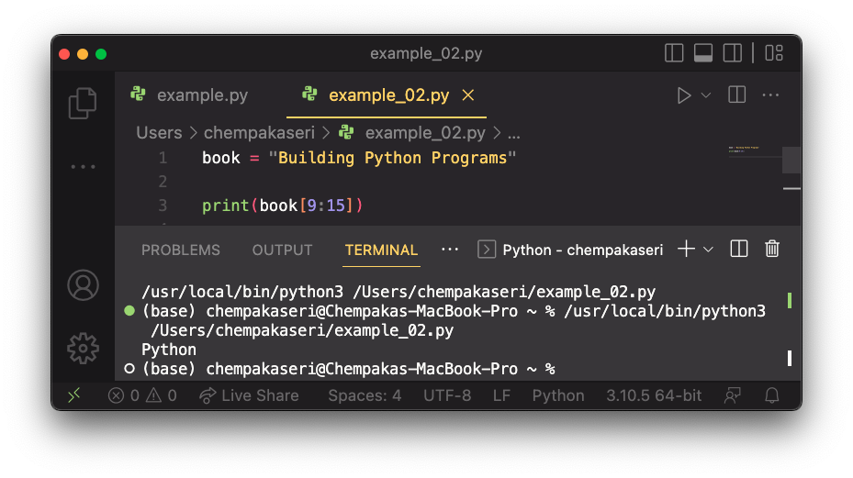
Accessing string using indexes
Given the following string
How would you extract the word “Python”?
book = "Building Python Programs"

Slide 26
String methods
These methods are called using the dot notation:
Method name | Description
find(str) | index where the start of the given string appears in this string (-1 if not found)
substring(index1, index2) or substring(index1) | the characters in this string from index1 (inclusive) to index2 (exclusive); if index2 is omitted, grabs till end of string
lower() | a new string with all lowercase letters
upper() | a new string with all uppercase letters
starz = "Biles & Manuel"
print(starz.lower())
Output: biles & manuel

Slide 27
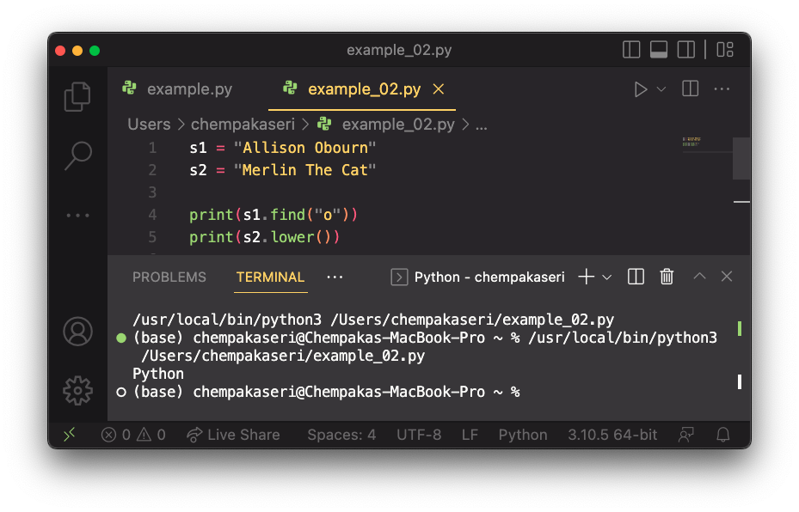
STRING METHOD EXAMPLES

Slide 28
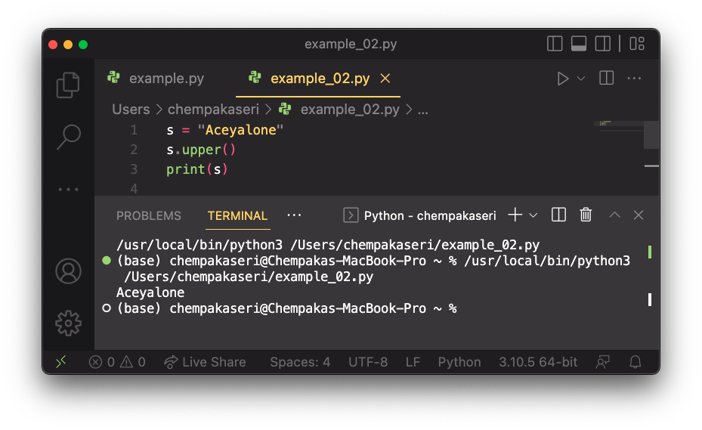
MODIFYING STRINGS
String operations and functions like lowercase build and return a new string, rather than modifying the current string.
To modify a variable’s value, you must reassign it:

Slide 29
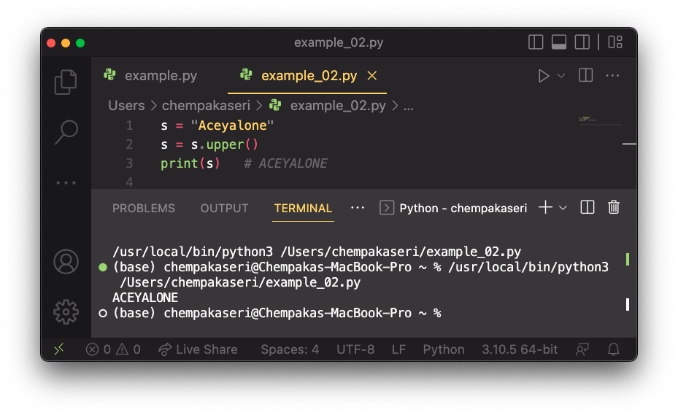
MODIFYING STRINGS
To modify a variable’s value, you must reassign it:

Slide 30
STRING TESTS
The in keyword can be used to test if a string contains another string
Method | Description
startswith(str) | whether one contains other's characters at start
endswith(str) | whether one contains other's characters at end
name = "Voldermort"
if name.startswith("Vol"):
print("He who must not be named")
name = "Voldermort"
if "er" in name:
print("He who must not be named")

Slide 31
string and int
All char values assigned numbers internally by the computer, called ASCII values.
Example:
One-character long String and ints can be converted to each other.
'A' is 65, 'B' is 66, ' ' is 32
'a' is 97, 'b' is 98, '*' is 42
ord('a') is 97, chr(103) is 'g'

Slide 32
EXERCISE
age = int(input("Enter your age >>"))
if age >= 18:
print("You are eligible for voting")
else:
print("You are underage")
Question 1
Write a program that check whether the user is eligible for voting or not. (Note: The eligible age for voting is 18).
Input: Age
Process: Check user age
Output: Display whether the age is eligible for voting or not

Slide 33
EXERCISE
cost = float(input("Enter the cost of the bike (RM)>>"))
if cost > 10000:
tax = cost * 0.15
elif cost > 5000 and cost <= 10000:
tax = cost * 0.1
else:
tax = cost * 0.05
print("The road tax for the bike is RM",tax)
Question 2
Write a program to accept the cost of a bike and display the road tax to be paid based on the following criteria:
Cost (RM) | Tax
> 10000 | 15%
> 5000 and <=10000 | 10%
<= 5000 | 5%
Input: Cost of a bike
Process: Check to cost to calculate the road tax
Output: Display the road tax based on the cost of the bike

